Slide 1
Operators

Slide 2
Type of Operator
Broadly can be divided into four groups: arithmetic, bitwise, relational, and logical.
Arithmetic Operators
Bitwise Operators
Relational Operators
Logical Operators
Assignment Operators
Ternary Operator

Slide 3
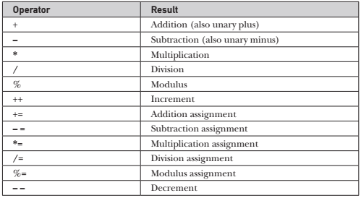
Arithmetic Operators
Arithmetic operators are used in mathematical expressions in the same way that they are used in algebra.
The operands of the arithmetic operators must be of a numeric type.
We cannot use them on boolean types, but we can use char types.

Slide 4
Arithmetic Operators
Basic Arithmetic Operators:
addition, subtraction, multiplication, and division: all work with all numeric types.
The Modulus Operator (%):
It returns the remainder of a division operation.
It can be applied to floating-point types as well as integer types.
Arithmetic Compound Assignment Operators:
Java provides special operators that can be used to combine an arithmetic operation with an assignment.
There are compound assignment operators for all of the arithmetic, binary operators.
var = var op expression; var op= expression;
a=a+10; a+=10;

Slide 5
Arithmetic Operators
Increment and Decrement :
The ++ and the – – are Java’s increment and decrement operators.
The increment operator increases its operand by one.
The decrement operator decreases its operand by one.
For example, this statement: x = x + 1;
can be rewritten by use of the increment operator: x++;
Similarly, this statement: x = x - 1;
is equivalent to x--;.
These operators are unique and can be used as postfix and prefix form
Postfix: operator follows operand, eg. x++;
Prefix: operator precede the operand, eg. ++x;

Slide 6
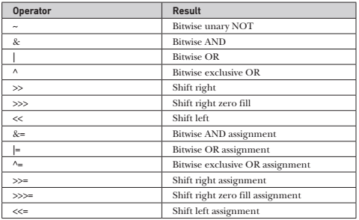
Bitwise Operators
Java defines several bitwise operators that can be applied to the integer types: long, int, short, char, and byte.
These operators act upon the individual bits of their operands.

Slide 7

Bitwise Operators
Bitwise Logical Operators:
The bitwise logical operators are &, |, ^, and ~.
Bitwise NOT ( ~):
Also called the bitwise complement, the unary NOT operator
inverts all of the bits of its operand.
Bitwise AND (&):
The AND operator, produces a 1 bit if both operands are also 1.
A zero is produced in all other cases.

Slide 8
Bitwise Operators
Bitwise Logical Operators:
The bitwise logical operators are &, |, ^, and ~.
Bitwise OR (|)
The OR operator, combines bits such that if either of the bits in the operands is a 1, then the resultant bit is a 1.
Bitwise XOR (^):
The XOR operator, combines bits such that if exactly one operand is 1, then the result is 1. Otherwise, the result is zero.

Slide 9
Bitwise Operators
Bitwise Logical Operators:
Left Shift (<<):
The left shift operator, shifts all of the bits in a value to the left a specified number of times.
value << num;
Right Shift (>>):
The right shift operator, shifts all of the bits in a value to the right a specified number of times.
value >> num;
Unsigned Right Shift (>>>):
This is known as an unsigned shift.
always shifts zeros into the high-order bit.

Slide 10
Bitwise Operators
Bitwise Operator Compound Assignments:
All of the binary bitwise operators have a compound form similar to that of the algebraic operators

Slide 11
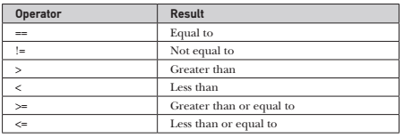
Relational Operators
The relational operators determine the relationship that one operand has to the other.
The outcome of these operations is a boolean value.
The relational operators are most frequently used in the expressions that control the if statement and the various loop statements.
Any type, including integers, floating-point numbers, characters, and Booleans can be compared using the equality test, ==, and the inequality test, !=.

Slide 12
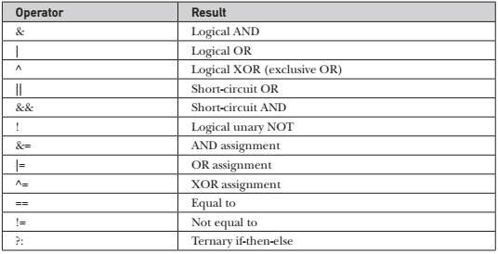
Logical Operators
Boolean Logical Operators

Slide 13
Assignment Operator
Assignment operators are used to assign values to variables.
The assignment operator is the single equal sign, =.
var = expression;

Slide 14
Ternary Operator
Java includes a special ternary (three-way) operator that can replace certain types of if-then-else statements.
expression1 ? expression2 : expression3
use of the ternary operator makes our code more readable and clean.
ternary operator can also be nested.

